Slide 2
Final Year Project (181606)

Slide 3
College Commune
Objective
“To establish an active medium for sharing
of information and schedule among COLLEGE
that give ease of communication”

Slide 4
Team Members
Harsh Bhakta (100010116004)
Vaishnavi Patel (100010116013)
Neel Maheshwari (100010116022)

Slide 5
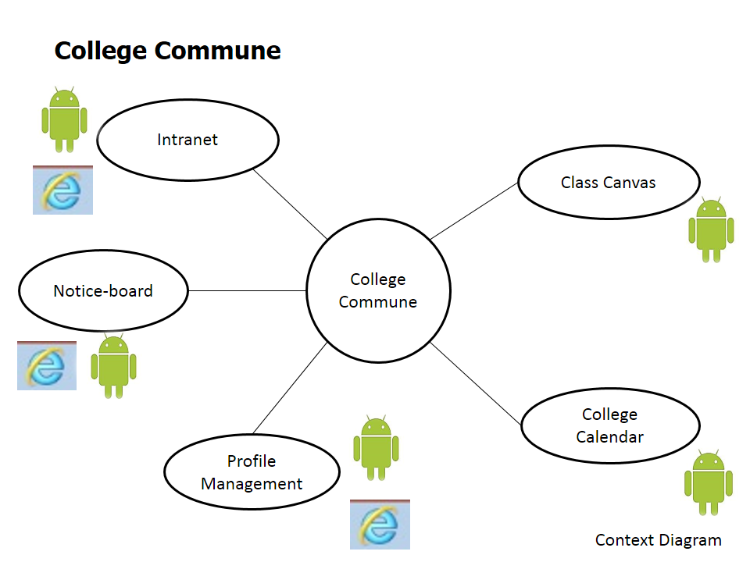
Over All module View

Slide 6
Duration and Type
The Project will last for a ONE year.
College Commune is an UDP type of project.

Slide 7
Over All Phases
We have Basically Following Phases:
Web Interface Designing for All Modules
(Except College Calendar and Class canvas)
Design classes and functionality and on basis of that to write Web-Services which Could be used for both (Web and Mobile Client)
Prepare Database Schema for all
To Develop an Android App as Mobile Client

Slide 8
Designing
We have Begin with the following three Module designing
Profile Registration Module
Intranet Module
Notice Board Module
The following module Implemented
Profile Registration Module

Slide 9
Objectives Achieved
Study of web application development techniques.
To learn Application development that follows MVC architecture.
Designed the database for Intranet and Notice Board module.
Designed DFD and Use Case diagrams for Intranet and Notice Board Module.
Implemented registration module and register user to the system in secure way.
Migrated database on MySql (phpMyAdmin)
Full setup for android in means of plugins, Universal Driver to use Device as emulator is done.
Begin with practical study of android and tools.

Slide 10

Registration module Process
Use case diagram
Activity Diagram
Request Generation and placement
Request Approve
New account Generation
DFD diagram
Level 0,1,2
Implementation
Implemented all the Use cases of this module

Slide 11

Intranet module Process
Use Case Diagram
Activity Diagram
Add User
Add Subject
Delete File
DFD Diagram
Level 0,1,2

Slide 12

Notice Board Module
Use Case Diagram
Class Diagram
DFD Diagram
Level 0,1,2

Slide 13
Future Enhancement
After developing a web application of Registration Module. We are planning to develop a mobile application of all modules.
As we are going to develop a mobile application on android supported phone, for that we learn how to make android application. This will result in newer application like
Student Profile Management
Class Canvas Module
We are going to write services for registration module that can be used by Android App.

Slide 14
Thank you

